Slide 1

Radially-Symmetric Silicone Bellow Soft Actuators For A Robotic Rehabilitation Exoglove
Guided by: Prof.S.Farokh Atashzar
Dr. Jacqueline Libby
Presented by - Arunagiri Adhithian Ravichandran
04/24/2023
M.Sc.Mechatronics and Robotics
Department of Mechanical and Aerospace Engineering

Slide 2

Agenda
Motivation
Previous Works and Problems
Our Solution
Improved Methods
Glove Design

Slide 3
Motivation

Slide 4
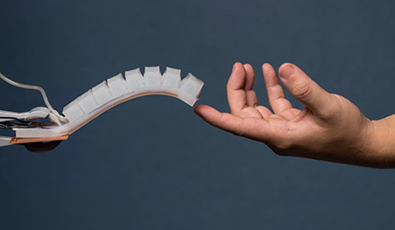
Why soft actuators for rehabilitation devices?
Inherent compliance match with the environment
Less rigid than human
Higher degree of freedom
Low weight
Low cost to manufacture
Non-linear output with a simple input

Slide 5
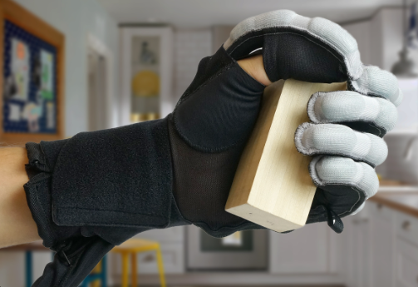
Why soft robotic glove for hand?
Human hands have one of the most complex biomechanical systems present in the body.
Quality and repetition must be precise in order to improve functionality.
Must be without assistance of the therapist.
Notes:
All the above criterias can only be achieved using a pneumatic hand glove. Because Pneumatic hand glove can produce highest force when microscaled. Hydraulic actuators can also be microscaled but has higher maintenance than pneumatic.
Moving toward Soft Robotics: A Decade Review of the Design of Hand Exoskeletons
Talha Shahid, Darwin Gouwanda *, Surya G. Nurzaman and Alpha A. Gopalai

Slide 6
Previous Works

Slide 7
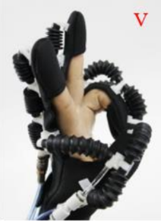
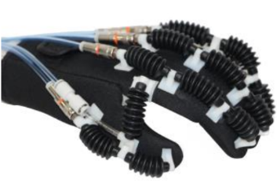
A Novel Soft Robotic Glove with Positive-negative Pneumatic Actuator for Hand Rehabilitation
Debin Hu*, Jinhua Zhang, Yuhan Yang, Qiuyang Li, Dahai Li and Jun Hong, Member, IEEE
Drawbacks:
Fabrication of actuators
Bulging
Glove design
Notes:
Fabrication of actuators - No control over material used / very less explanation for the dimensions of the actuator except for the length.
Glove design - Explanation in the paper doesn’t match the actual product

Slide 8
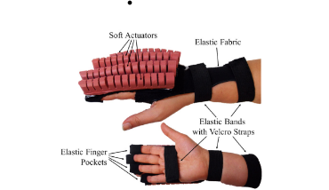
Towards a Soft Pneumatic Glove for Hand Rehabilitation
Panagiotis Polygerinos*, Member, IEEE, Stacey Lyne, Zheng Wang, Member, IEEE, Luis Fernando Nicolini, Bobak Mosadegh, George M. Whitesides and Conor J. Walsh, Member, IEEE.
Drawbacks:
No negatively pressure
Bulky
Slow actuation
Missing thumb actuation
Notes:
Negative pressure is not used - instead elastic material is used for retraction motion of the actuator

Slide 9
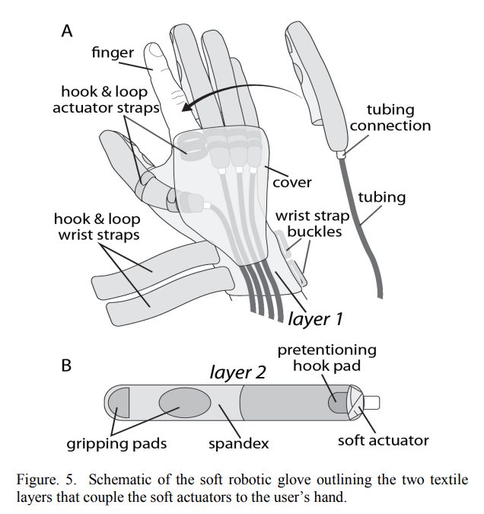
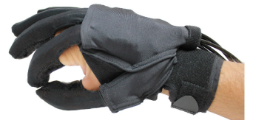
Soft Robotic Glove for Hand Rehabilitation and Task Specific Training
Panagiotis Polygerinos, Member, IEEE, Kevin C. Galloway, Emily Savage, Maxwell Herman, Kathleen O’ Donnell and Conor J. Walsh*
Drawbacks:
No negative pressure.
No adduction and abduction
Notes:
No negatively pressure

Slide 10
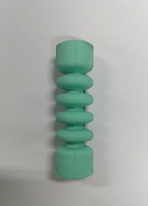
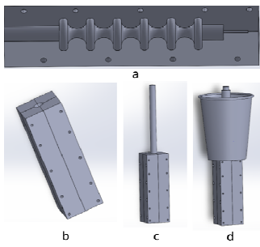
A New Fabrication Method for Soft Pneumatic Actuators based on Paraffin
Jin Guo*, Shuxiang Guo, Fengze Lyu, Maoxun Li
Drawbacks:
Shrinkage
Additional Fixtures
Notes:
No negatively pressure

Slide 11
Drawbacks to be addressed?
Slow actuation
Bulging
Bulkiness
Negative pressure
Thumb flexion/extension
Shrinkage of wax
Glove design

Slide 12
Our Solution

Slide 13
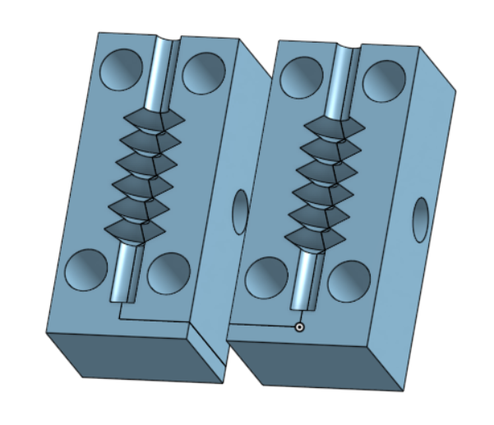
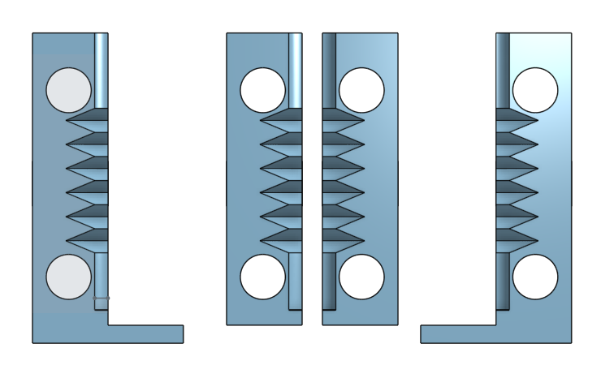
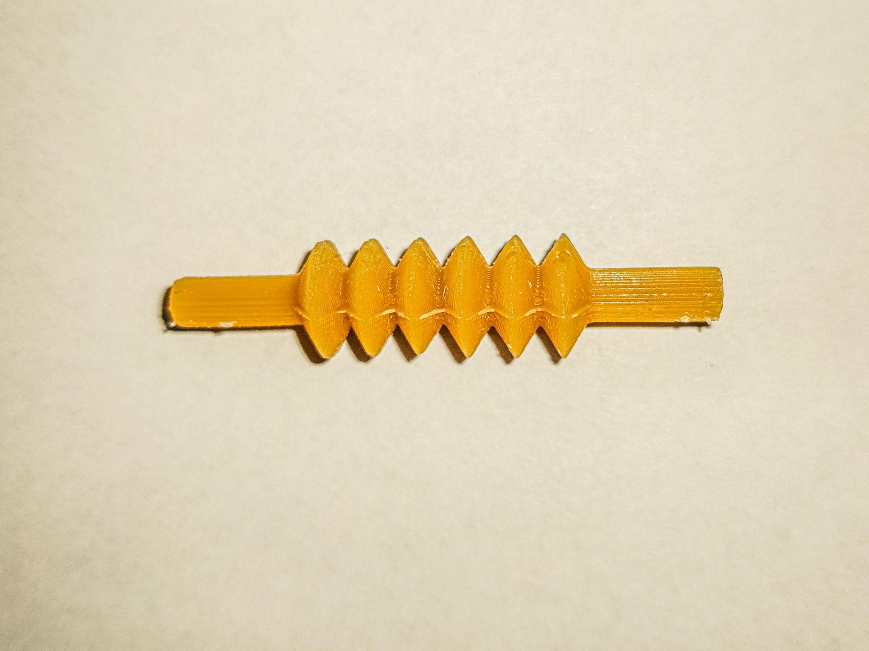
Miniature Bellow actuators
Inner core:
Wax inner core
Beeswax
Melted at 177℉
Continuous pour
Cured for 24 hours
Usage:
Easy to design inner core for any outer silicone core.

Slide 14
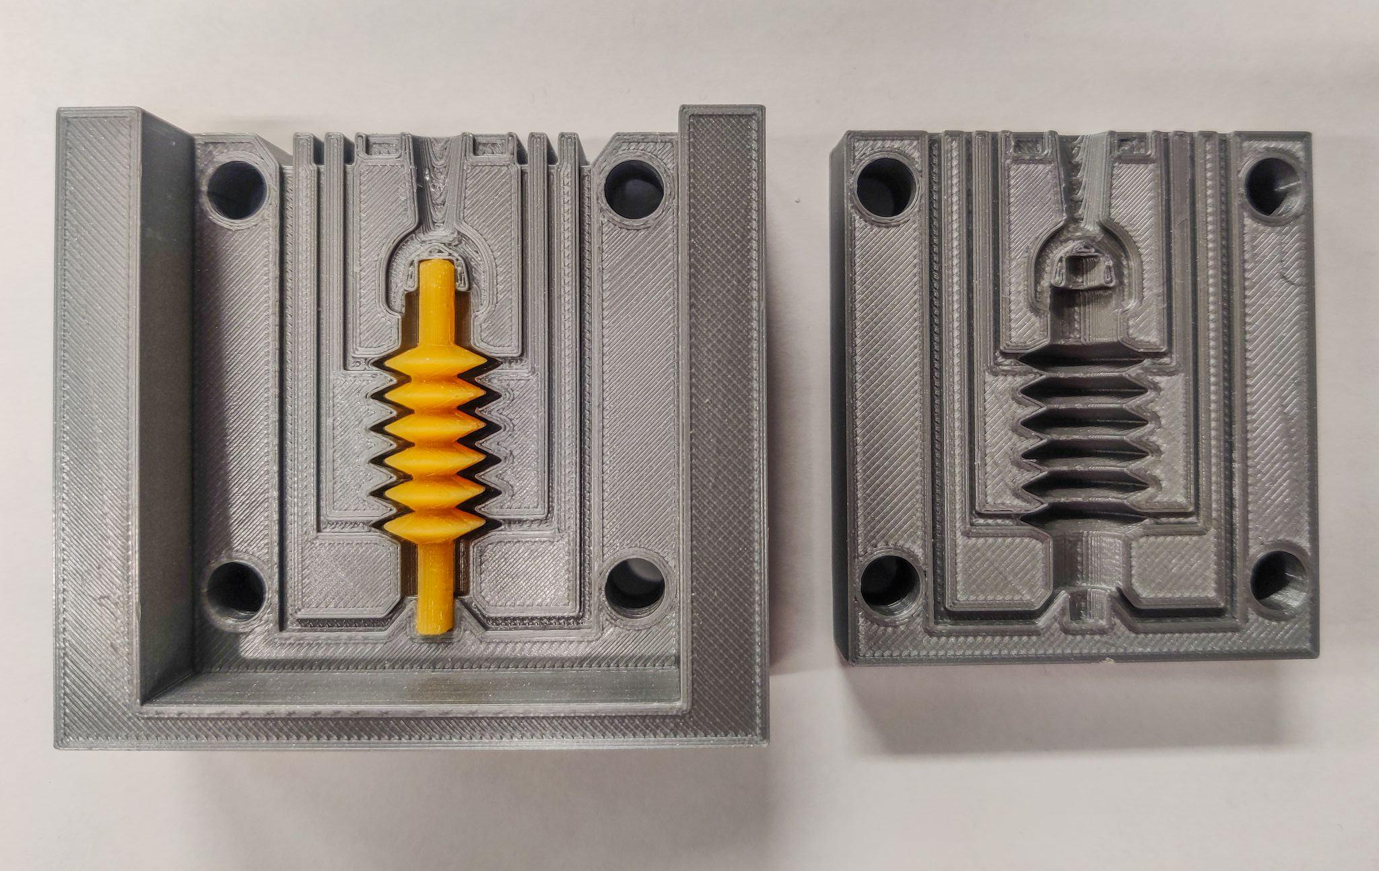
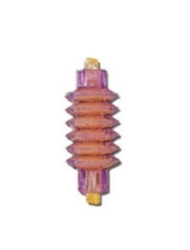
Outer core:
Sorta Clear - 40 silicone degassed using a vacuum chamber.
Injection molding in 3D printed PLA molds.
Pot life 60 mins.
Curing time is 16 Hrs
Usage:
Softer silicone can create high frequency of motion.
Notes:
Degassing - many times since the viscosity of this type of silicone is less.

Slide 15
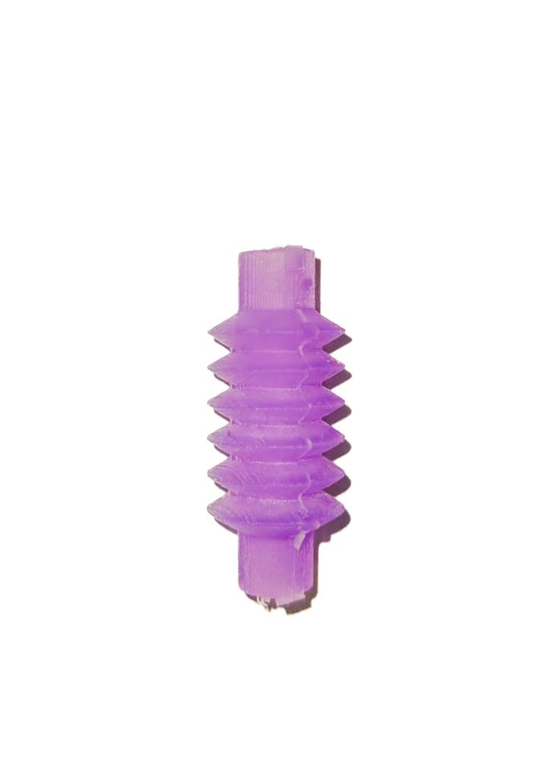
Removing inner core:
Using heat gun at 460℉
Followed by two hot water baths to clean the actuator.
First bath to remove the unmelted wax particles.
Second bath is to remove the residual wax particles along the inner walls.

Slide 16
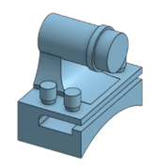
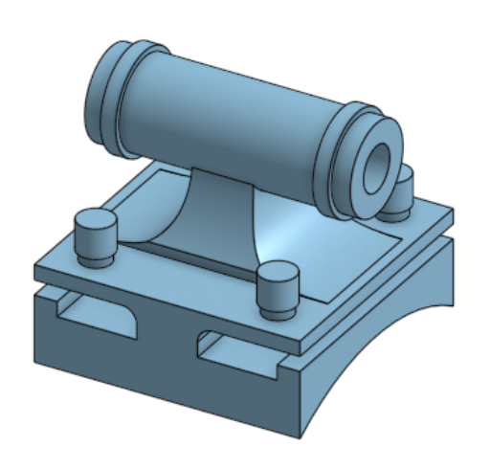
Connectors
Blockers at the actuator and the ends of the fingers.
Connectors connect two actuators.
Connector and blocker 3D printed using PLA.
Usage
Connectors create a passage for air to flow.
Blockers prevent the escape of air from the system.

Slide 17
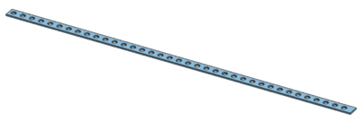
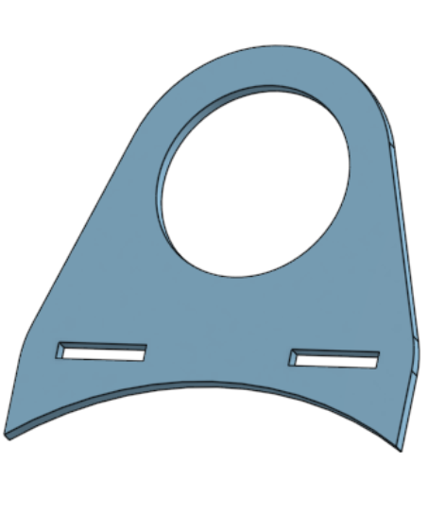
Reinforcement parts:
TPU based rings and limiting layers.
3D printed at thickness of 0.7mm for flexibility.
Usage:
TPU limiting layer is used for helping the actuator for curling.
TPU limiting rings used preventing from bulging.

Slide 18
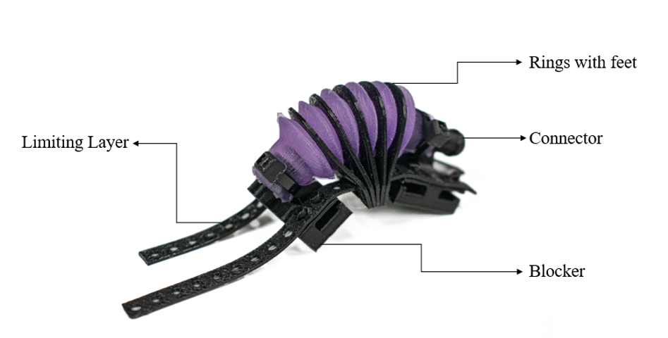
Completely assembled actuator:

Slide 19
Improved Methods

Slide 20
Old degassing method
In the 1st iteration of degassing of Sorta Clear - 40 was done by, mixing the mixture using stick between each round of degassing to remove the bubbles from the mixture.
New degassing method
In the new method, each round of degassing is done until all bubbles rise up till then reach the state of blow up, when which air is let into the chamber to abruptly burst the bubbles.
Cause of the new method - Degassing time reduced from approximately 40 mins to 20-25 mins

Slide 21
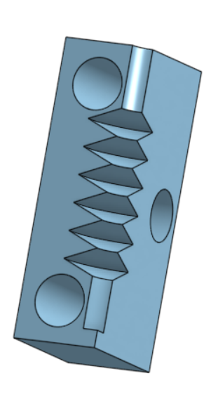
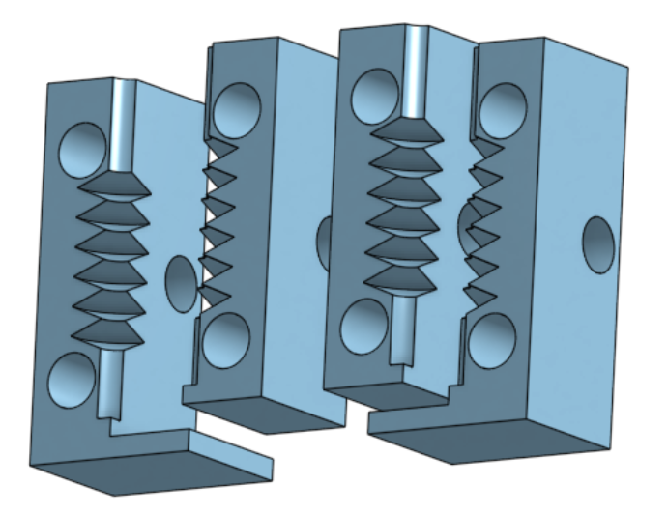
Old wax mold with no alignment
(printed in 4 quarters)
New wax mold with alignment
Notes:
Prevents inner core from being misaligned, so that inner core is not of dimensions.

Slide 22
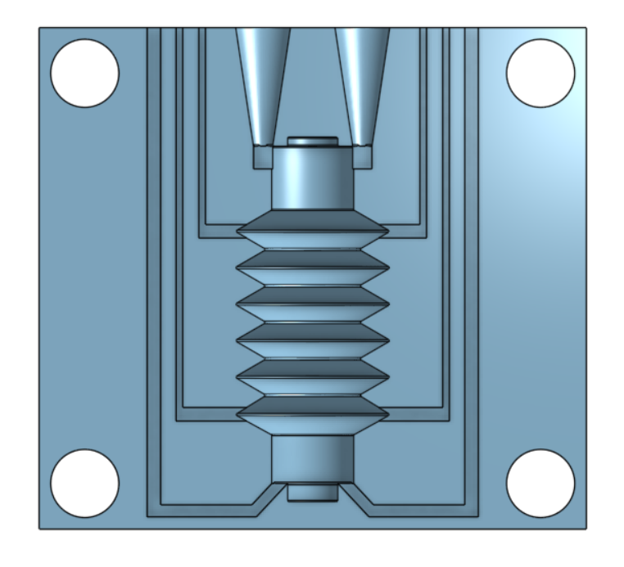
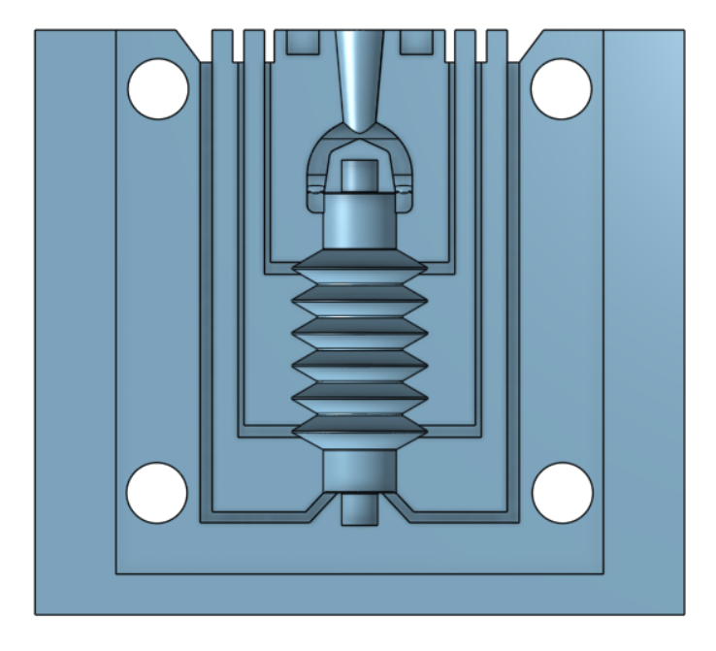
Double hole with passageways closer to each other
Single hole with passageways faraway from each other
0.75 mm
4 mm
1.5 mm
2.75 mm
2.25 mm
Notes:
Engraving on top to prevent silicone from overlapping holes on top
Slot for screw driver to help open the mold after curing.

Slide 23
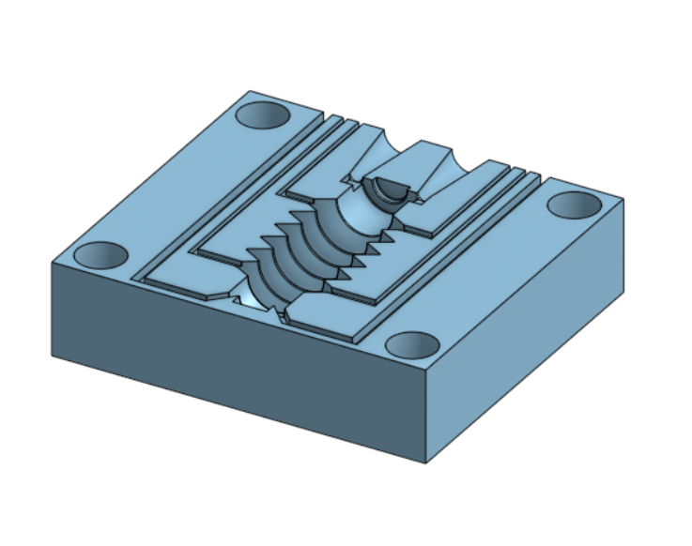
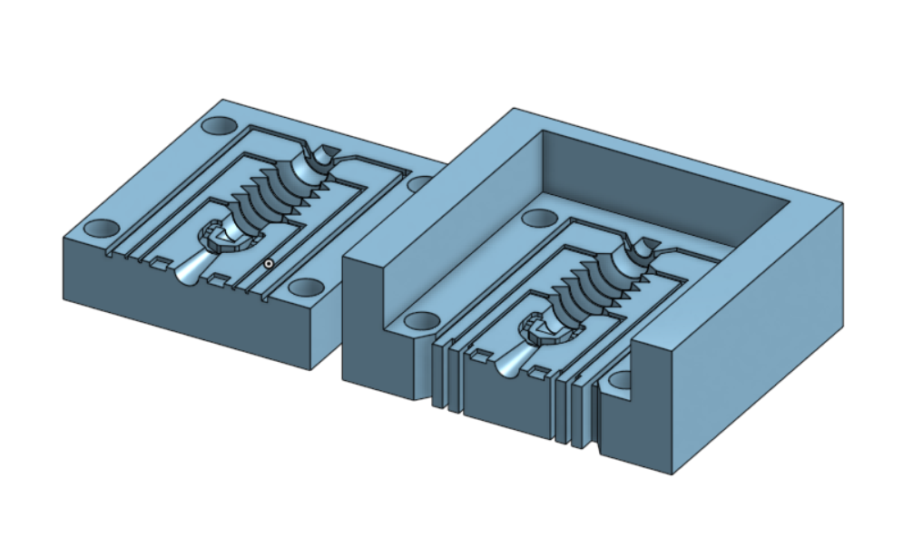
Old mold with alignment problem
New mold with alignment on three sides
Notes:
Prevents the actuator’s half side being different in alignment with other half

Slide 24
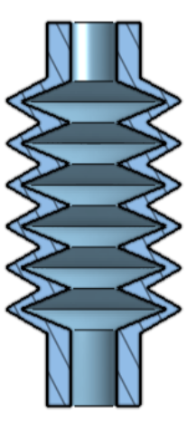
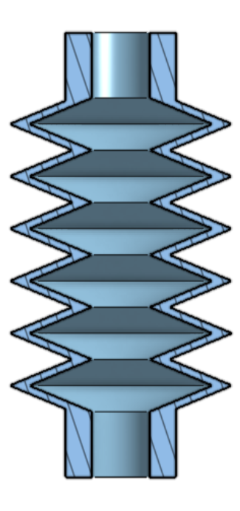
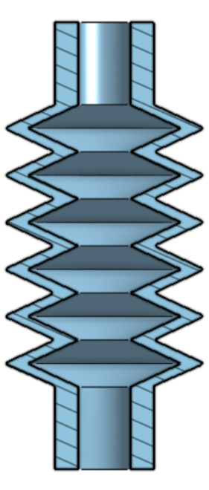
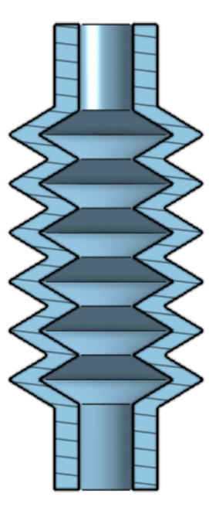
From old mold (not parallel)
1st iteration (1.5mm)
2nd iteration (2mm)
3rd iteration (2.5mm)
5 mm
5 mm
7 mm
7 mm
7 mm
5 mm
7 mm
7 mm
1.351mm (Peak)
2.999mm (Valley)
1.420mm (Peak)
1.580mm (Valley)
1.794mm (Peak)
2.206mm (Valley)
2.361mm (Peak)
2.639mm (Valley)
Thickness at peaks and valleys

Slide 25
From old mold (not parallel)
1st iteration (1.5mm)
2nd iteration (2mm)
3rd iteration (2.5mm)
Variable Thickness
(Min - 0.752mm)
0.577mm
0.843mm
1.296mm
Wall thickness

Slide 26
Glove Design

Slide 27
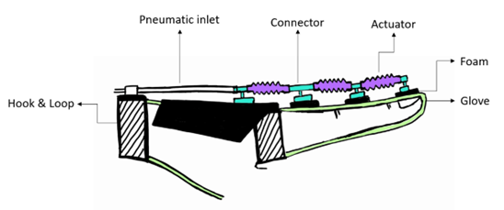
Glove construction
Soft knit glove (manufactured by Achiou)
Outer layer (86% acrylic, 13% polyester and 1% spandex)
Inner layer (100% polyester)
Foams and 3D printed PLA parts are attached using superglue.

Slide 28
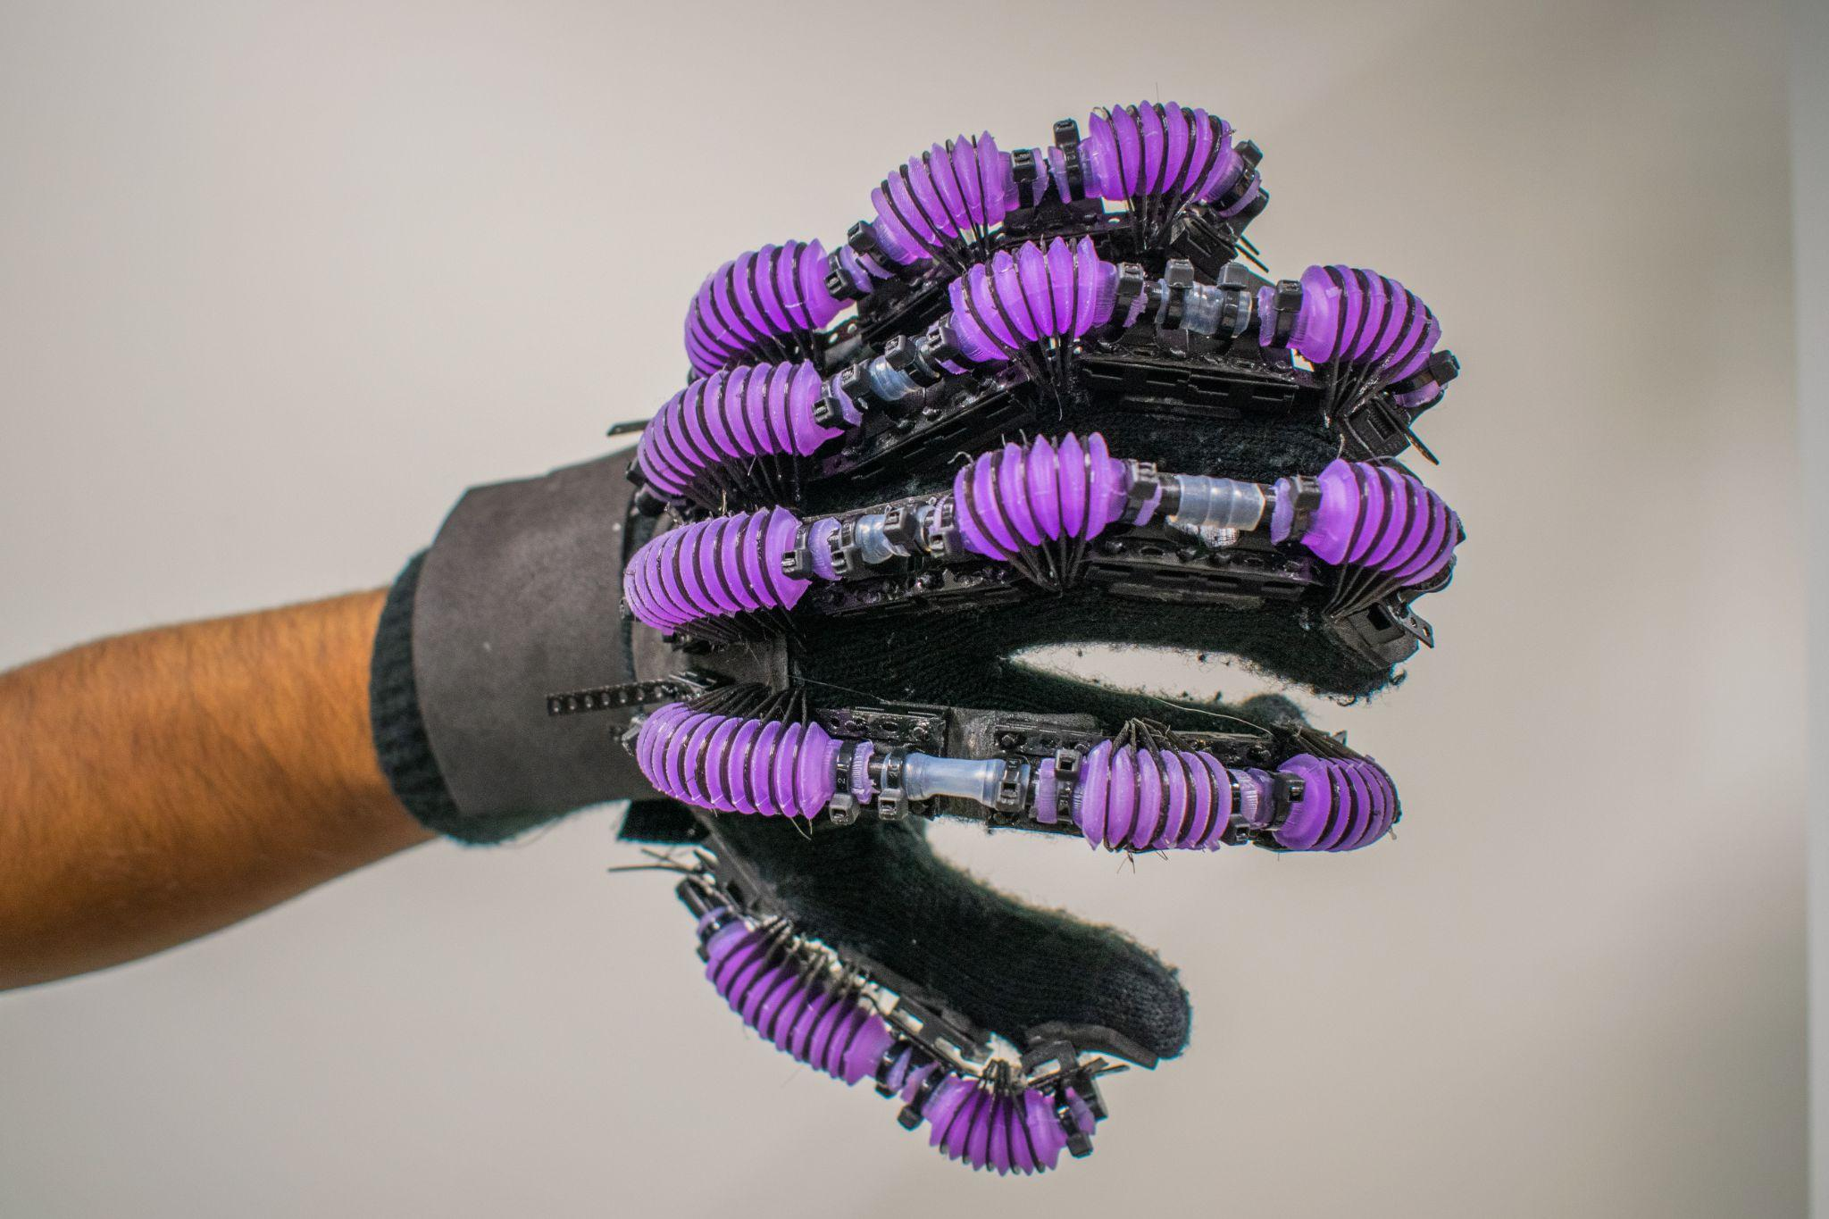
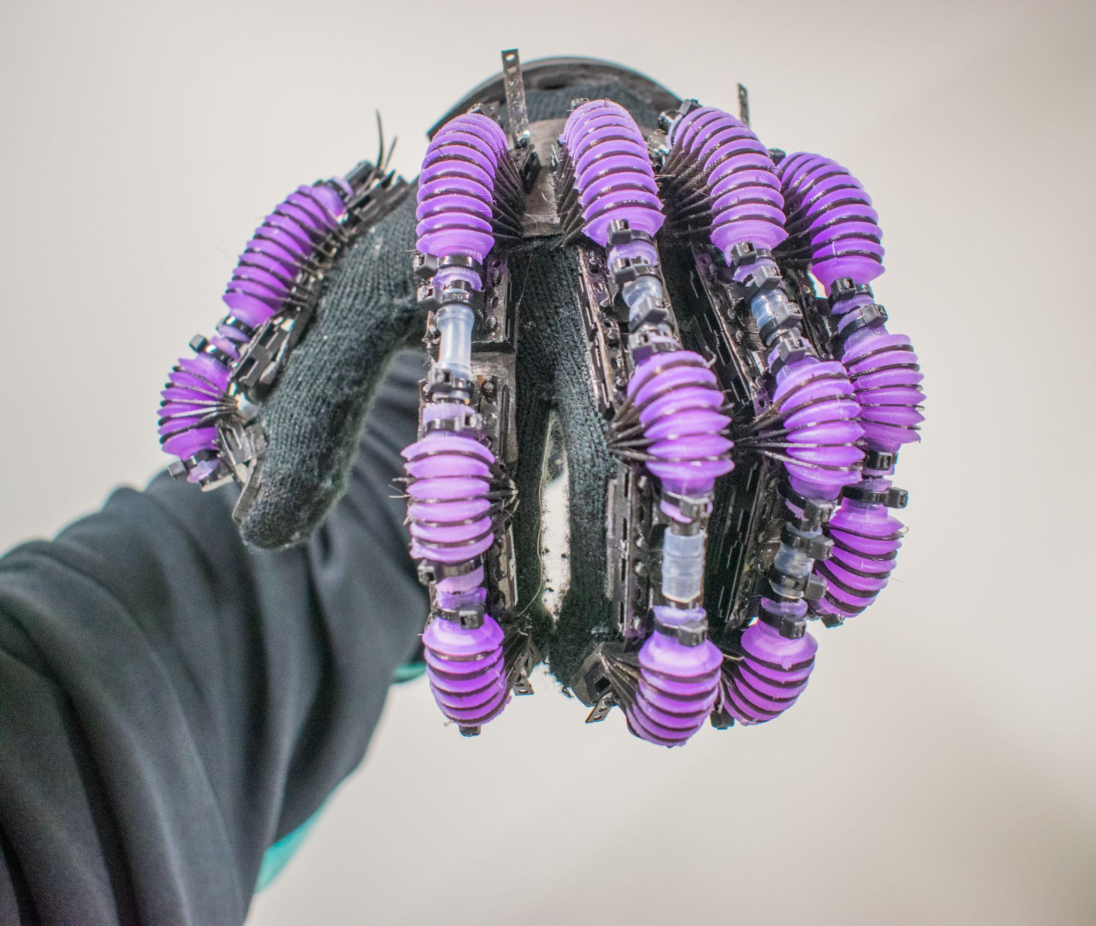
Real life model of the glove

Slide 29
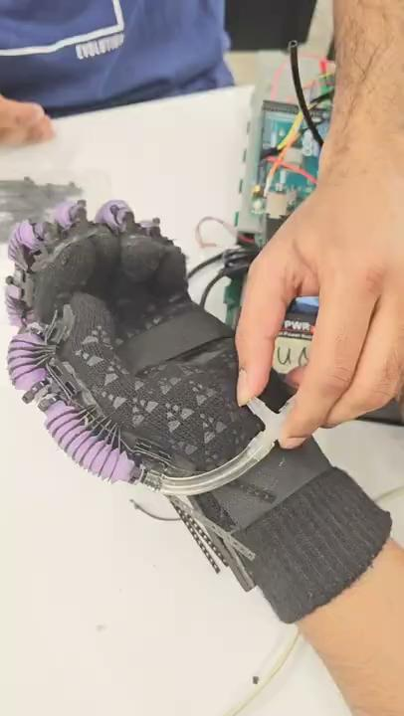
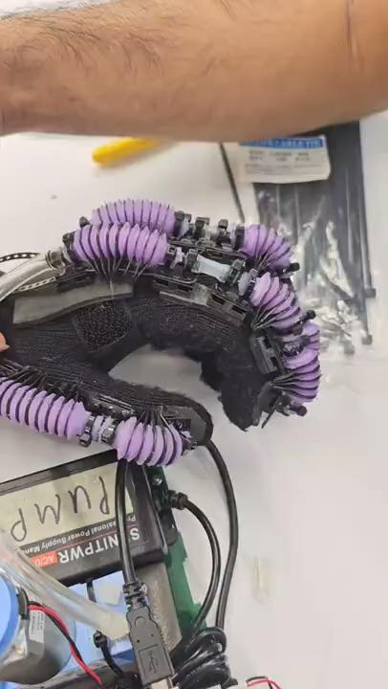
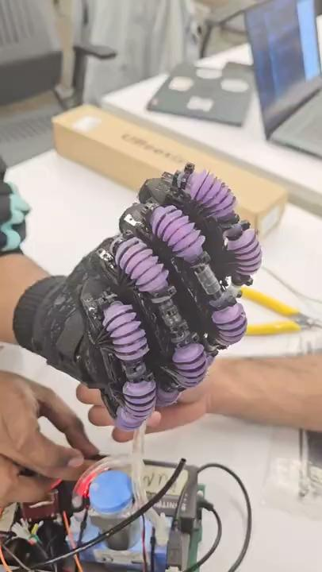
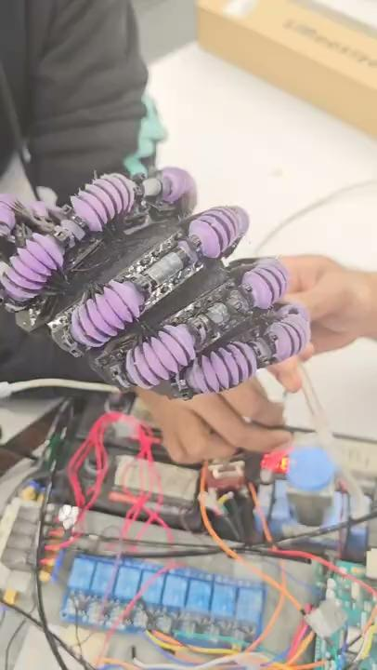
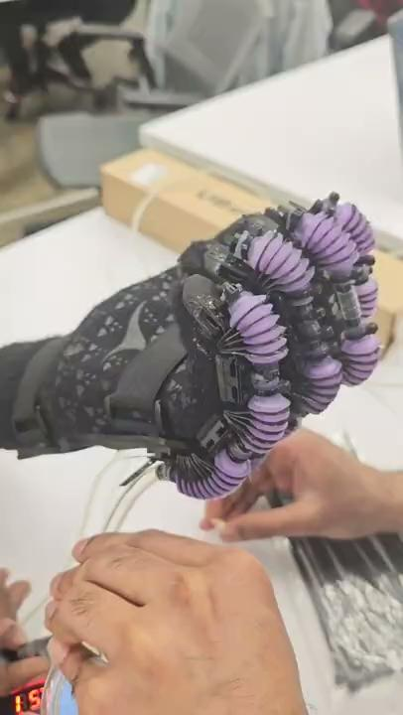
Glove actuation (Positive Pressure)
Thumb Finger
Index Finger
Middle Finger
Ring Finger
Little Finger

Slide 30
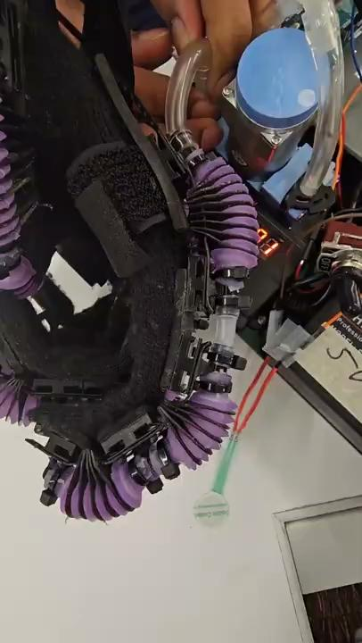
Glove actuation (Negative Pressure)

Slide 31
Future Work
The actuator’s wall thickness can be fine tuned.
Softer silicone materials for the actuator can be tested out.
Actuator can be programmed for particular directions.
Feasible pump generating both negative and positive air pressure needs to be created in order to perform complex ADL at a higher frequency.
Adduction/abduction actuator for the thumb.
Lighter 3D printable parts can be manufactured to reduce the weight of the glove.

Slide 32

Acknowledgements
Thank you
Prof.S.Farokh Atashzar
Dr.Jacqueline Libby
Sarmad Mehrdad
Gayatri Tyagi
Jessica Espinoza
Naigam Bhatt
Aadit P
All members of the MERIIT family

Slide 33
Thank You

